Slide 1
Deep learning to the rescue solving long standing problems of recommender systems
Balázs Hidasi
@balazshidasi
Budapest RecSys & Personalization meetup
12 May, 2016

Slide 2
What is deep learning?
A class of machine learning algorithms
that use a cascade of multiple non-linear processing layers
and complex model structures
to learn different representations of the data in each layer
where higher level features are derived from lower level features
to form a hierarchical representation.
Key component of recent technologies
Speech recognition
Personal assistants (e.g. Siri, Cortana)
Computer vision, object recognition
Machine translation
Chatbot technology
Face recognition
Self driving cars
An efficient tool for certain complex problems
Pattern recognition
Computer vision
Natural language processing
Speech recognition
Deep learning is NOT
the true AI
it may be a component of it when and if AI is created
how the human brain works
the best solution to every machine learning tasks

Slide 3
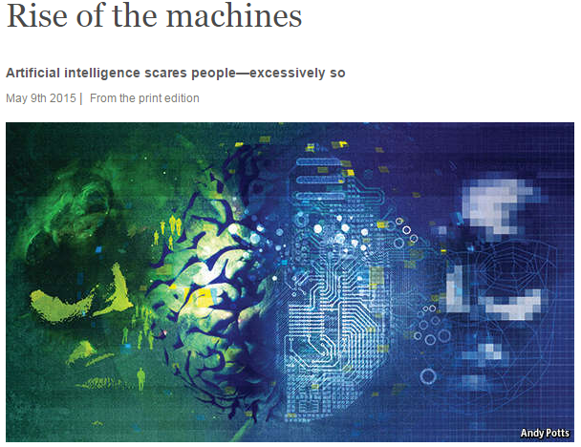
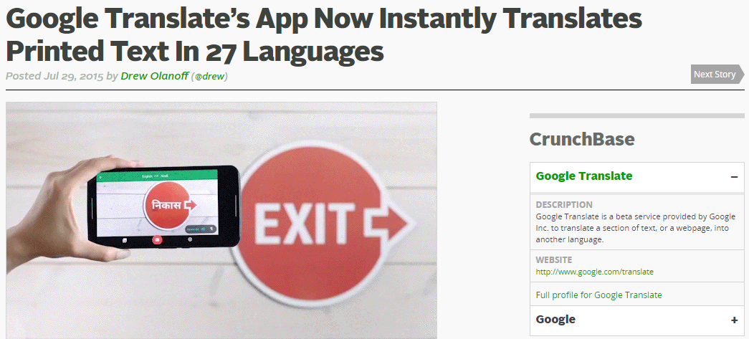
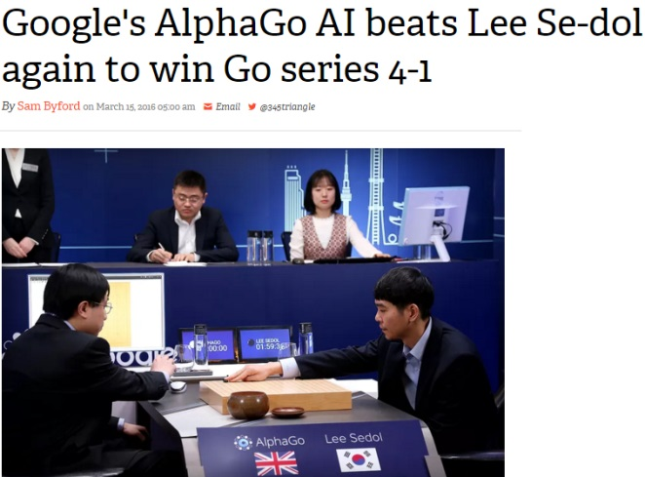
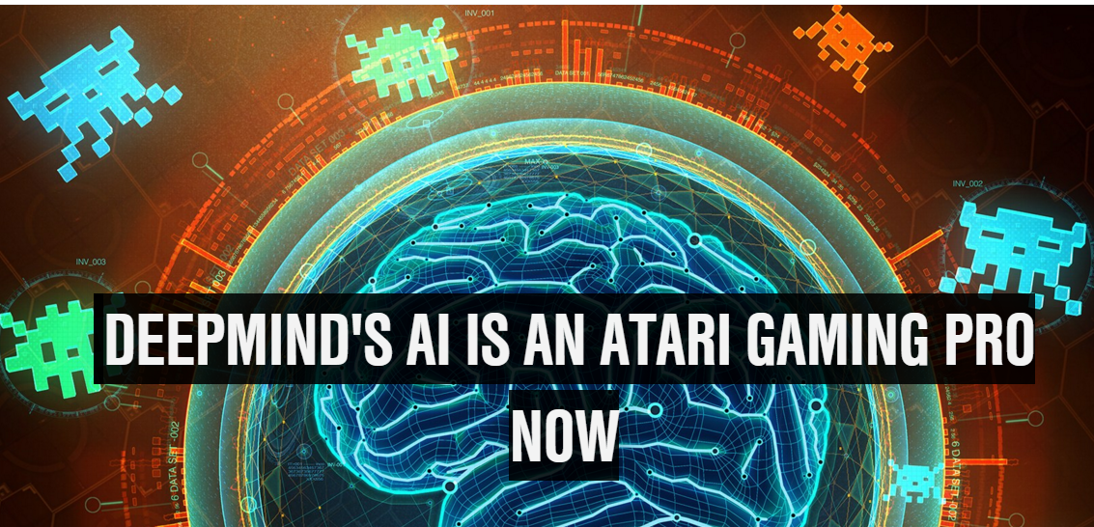
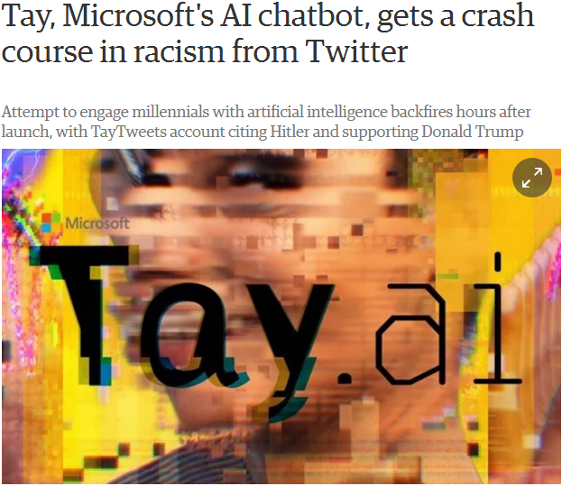
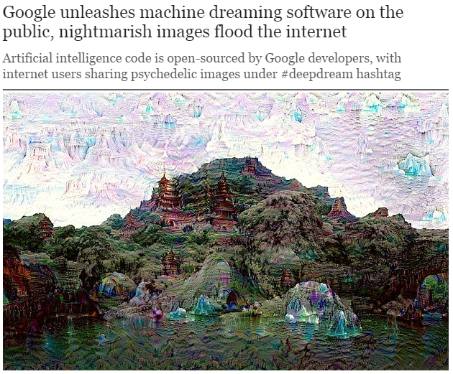
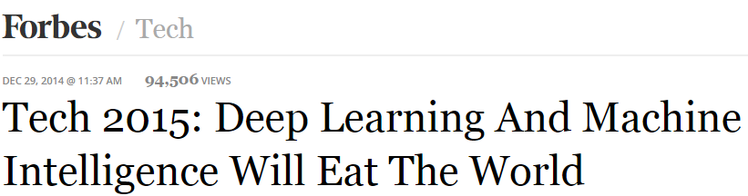
Deep learning in the news

Slide 4
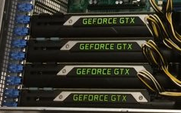
Why is deep learning happening now?
Actually it is not ☺ → first papers published in 1970s
Third resurgence of neural networks
Research breakthroughs
Increase in computational power
GP GPUs
 | Problem | Solution
Vanishing gradients | Sigmoid type activation functions easily saturate. Gradients are small, in deeper layers updates become almost zero. | Earlier: layer-by-layer pretraining Recently: non-saturating activation functions
Gradient descent | First order methods (e.g. SGD) are easily stuck. Second order methods are infeasible on larger data. | Adaptive training: adagrad, adam, adadelta, RMSProp Nesterov momentum
Regularization | Networks easily overfit (even with L2 regularization). | Dropout
ETC...

Slide 5
Challenges in RecSys
Recommender systems ≠ Netflix challenge
Rating prediction ←→ Top-N recommendation (ranking)
Explicit feedback ←→ Implicit feedback
Long user histories ←→ Sessions
Slowly changing taste ←→ Goal oriented browsing
Item-to-user only ←→ Other scenarios
Success of CF
Human brain is a powerful feature extractor
Cold-start
CF can’t be used
Decisions are rarely made on metadata
But rather on what the user sees: e.g. product image, content itself
Domain
dependent

Slide 6
Session-based recommendations
Permanent cold start
User identification
Possible but often not reliable
Intent/theme
What the user needs?
Theme of the session
Never/rarely returning users
Workaround in practice
Item-to-item recommendations
Similar items
Co-occurring items
Non-personalized
Not adaptive

Slide 7
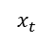
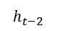
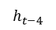

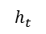

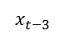
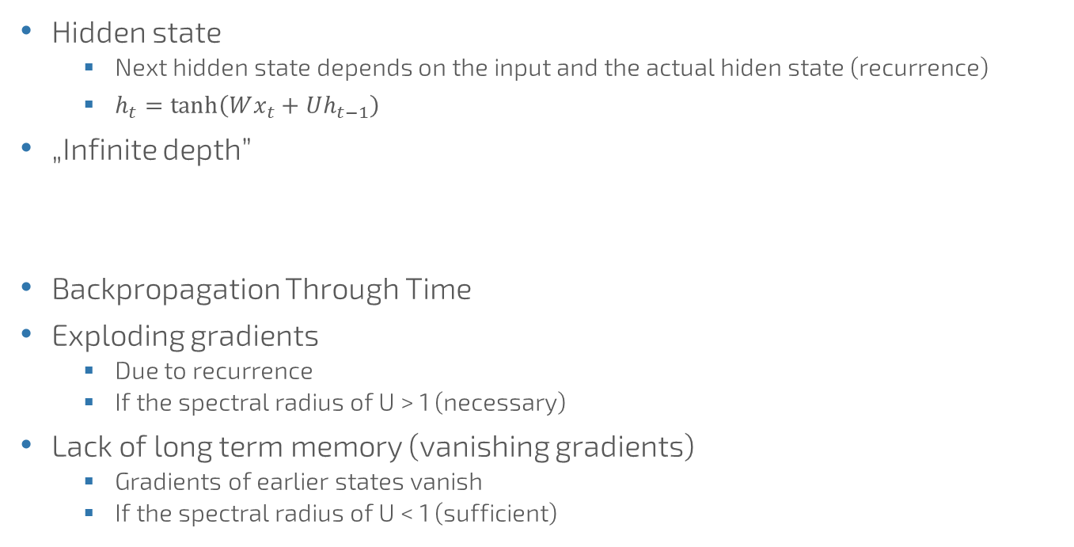
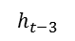

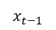
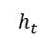

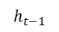
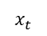

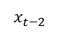
Recurrent Neural Networks
Hidden state
Next hidden state depends on the input and the actual hidden state (recurrence)
$h_{t}=\tanh\left(Wx_{t}+Uh_{t−1}\right)$
„Infinite depth”
Backpropagation Through Time
Exploding gradients
Due to recurrence
If the spectral radius of U > 1 (necessary)
Lack of long term memory (vanishing gradients)
Gradients of earlier states vanish
If the spectral radius of U < 1 (sufficient)
$$x_{t}$$
$$h$$
$$h_{t}$$
$$h_{t}$$
$$h$$
$$x_{t}$$
$$h_{t−1}$$
$$h$$
$$x_{t−1}$$
$$h$$
$$x_{t−2}$$
$$h_{t−2}$$
$$h$$
$$x_{t−3}$$
$$h_{t−3}$$
$$h_{t−4}$$

Slide 8


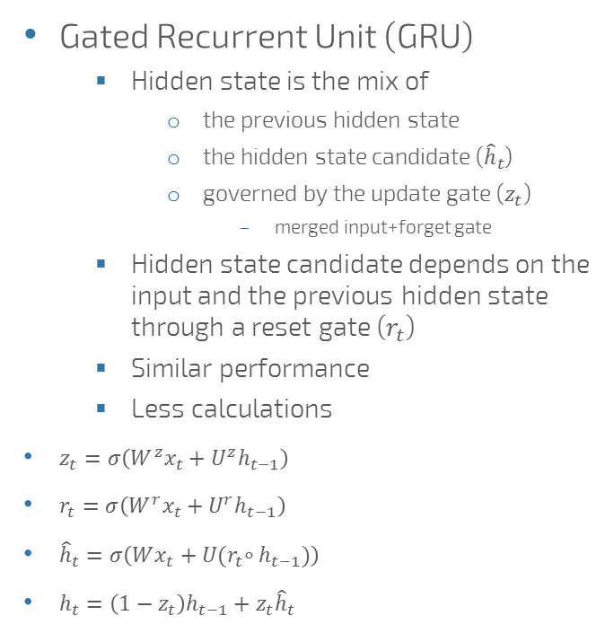
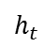

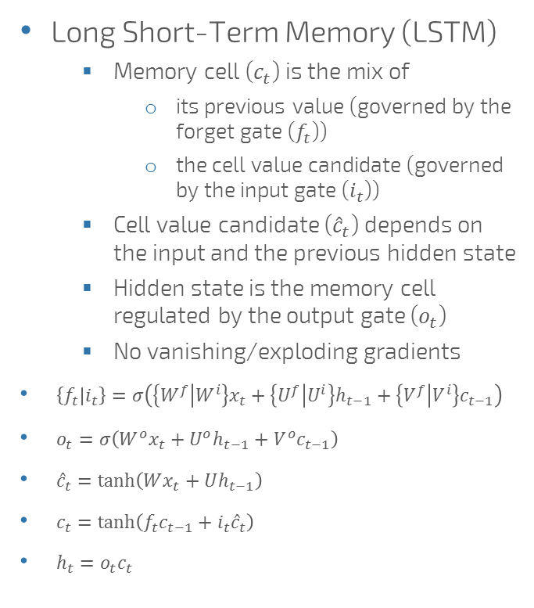
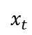





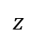

Advanced RNN units
Long Short-Term Memory (LSTM)
Memory cell ($c_{t}$) is the mix of
its previous value (governed by the forget gate ($f_{t}$))
the cell value candidate (governed by the input gate ($i_{t}$))
Cell value candidate (${\hat{c}}_{t}$) depends on the input and the previous hidden state
Hidden state is the memory cell regulated by the output gate ($o_{t}$)
No vanishing/exploding gradients
$\left\{f_{t} | i_{t}\right\}=σ\left(\left\{W^{f} | W^{i}\right\}x_{t}+\left\{U^{f} | U^{i}\right\}h_{t−1}+\left\{V^{f} | V^{i}\right\}c_{t−1}\right)$
$o_{t}=σ\left(W^{o}x_{t}+U^{o}h_{t−1}+V^{o}c_{t−1}\right)$
${\hat{c}}_{t}=\tanh\left(Wx_{t}+Uh_{t−1}\right)$
$c_{t}=\tanh\left(f_{t}c_{t−1}+i_{t}{\hat{c}}_{t}\right)$
$h_{t}=o_{t}c_{t}$
Gated Recurrent Unit (GRU)
Hidden state is the mix of
the previous hidden state
the hidden state candidate (${\hat{h}}_{t}$)
governed by the update gate ($z_{t}$)
merged input+forget gate
Hidden state candidate depends on the input and the previous hidden state through a reset gate ($r_{t}$)
Similar performance
Less calculations
$z_{t}=σ\left(W^{z}x_{t}+U^{z}h_{t−1}\right)$
$r_{t}=σ\left(W^{r}x_{t}+U^{r}h_{t−1}\right)$
${\hat{h}}_{t}=σ\left(Wx_{t}+U{(r}_{t}∘h_{t−1})\right)$
$h_{t}=\left(1−z_{t}\right)h_{t−1}+z_{t}{\hat{h}}_{t}$
$$z$$
$$x_{t}$$
$$h$$
$$r$$
$$\hat{h}$$
$$x_{t}$$
$$f$$
$$i$$
$$\hat{c}$$
$$h_{t}$$
$$c$$
$$o$$
$$h$$
$$h_{t}$$

Slide 9
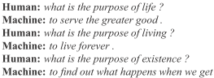
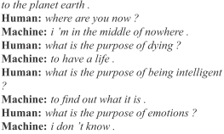
Powered by RNN
Sequence labeling
Document classification
Speech recognition
Sequence-to-sequence learning
Machine translation
Question answering
Conversations
Sequence generation
Music
Text

Slide 10
Session modeling with RNNs
Input: actual item of session
Output: score on items for being the next in the event stream
GRU based RNN
RNN is worse
LSTM is slower (same accuracy)
Optional embedding and feedforward layers
Better results without
Number of layers
1 gave the best performance
Sessions span over short timeframes
No need for modeling on multiple scales
Requires some adaptation
Output: scores on all items
Feedforward layers
(optional)
GRU layer
…
GRU layer
GRU layer
Embedding layers
(optional)
Input: actual item, 1-of-N coding

Slide 11
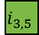
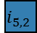
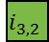
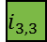
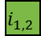
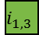
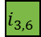
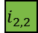
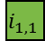
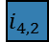
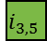
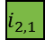
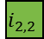

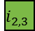
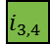
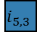
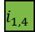
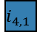
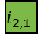
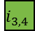

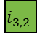
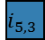

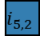
















Adaptation: session parallel mini-batches
Motivation
High variance in the length of the sessions (from 2 to 100s of events)
The goal is to capture how sessions evolve
Minibatch
Input: current evets
Output: next events
Mini-batch3
Mini-batch2
Mini-batch1
Active sessions
First X
Finished sessions replaced by the next available
Input
(item of the
actual event)
$$i_{1,1}$$
$$i_{1,2}$$
$$i_{1,3}$$
$$i_{5,1}$$
$$i_{5,2}$$
…
Session1
Session2
Session3
Session4
Session5
$$i_{1,1}$$
$$i_{1,2}$$
$$i_{1,3}$$
$$i_{1,4}$$
$$i_{2,1}$$
$$i_{2,2}$$
$$i_{4,1}$$
…
$$i_{2,1}$$
$$i_{2,2}$$
$$i_{2,3}$$
$$i_{3,1}$$
$$i_{3,2}$$
$$i_{3,3}$$
$$i_{3,4}$$
$$i_{3,5}$$
…
$$i_{3,1}$$
$$i_{3,2}$$
$$i_{3,3}$$
$$i_{3,4}$$
$$i_{3,5}$$
$$i_{3,6}$$
$$i_{4,1}$$
$$i_{4,2}$$
$$i_{1,2}$$
$$i_{1,3}$$
$$i_{1,4}$$
$$i_{5,2}$$
$$i_{5,3}$$
…
$$i_{5,1}$$
$$i_{5,2}$$
$$i_{5,3}$$
Desired output
(next item in the
event stream)
$$i_{2,2}$$
$$i_{2,3}$$
$$i_{4,2}$$
…
$$i_{3,2}$$
$$i_{3,3}$$
$$i_{3,4}$$
$$i_{3,5}$$
$$i_{3,6}$$
…
…

Slide 12

Adaptation: pairwise loss function
Motivation
Goal of recommender: ranking
Pairwise and pointwise ranking (listwise costly)
Pairwise often better
Pairwise loss functions
Positive items compared to negatives
BPR
Bayesian personalized ranking
$L=−\frac{1}{N_{S}}\sum_{j=1}^{N_{S}}{\log\left(σ\left({\hat{r}}_{s,i}−{\hat{r}}_{s,j}\right)\right)}$
TOP1
Regularized approximation of the relative rank of the positive item
$L=\frac{1}{N_{S}}\sum_{j=1}^{N_{S}}{σ\left({\hat{r}}_{s,i}−{\hat{r}}_{s,j}\right)}+σ\left({\hat{r}}_{s,j}^{2}\right)$

Slide 13




























Adaptation: sampling the output
Motivation
Number of items is high → bottleneck
Model needs to be trained frequently (should be quick)
Sampling negative items
Popularity based sampling
Missing event on popular item → more likely sign of negative feedback
Pop items often get large scores → faster learning
Negative items for an example: examples of other sessions in the minibatch
Technical benefits
Follows data distribution (pop sampling)
Positive item
Inactive outputs (not computed)
Sampled negative items
$${\hat{y}}_{1}^{1}$$
$${\hat{y}}_{2}^{1}$$
$${\hat{y}}_{3}^{1}$$
$${\hat{y}}_{4}^{1}$$
$${\hat{y}}_{5}^{1}$$
$${\hat{y}}_{6}^{1}$$
$${\hat{y}}_{7}^{1}$$
$${\hat{y}}_{8}^{1}$$
1
0
0
0
0
0
0
0
$$i_{1}$$
$$i_{5}$$
$$i_{8}$$
$${\hat{y}}_{1}^{2}$$
$${\hat{y}}_{2}^{2}$$
$${\hat{y}}_{3}^{2}$$
$${\hat{y}}_{4}^{2}$$
$${\hat{y}}_{5}^{2}$$
$${\hat{y}}_{6}^{2}$$
$${\hat{y}}_{7}^{2}$$
$${\hat{y}}_{8}^{2}$$
0
0
0
0
1
0
0
0
Mini-batch
(desired items)
$${\hat{y}}_{1}^{3}$$
$${\hat{y}}_{2}^{3}$$
$${\hat{y}}_{3}^{3}$$
$${\hat{y}}_{4}^{3}$$
$${\hat{y}}_{5}^{3}$$
$${\hat{y}}_{6}^{3}$$
$${\hat{y}}_{7}^{3}$$
$${\hat{y}}_{8}^{3}$$
0
0
0
0
0
0
0
1
Network output (scores)
Desired output scores

Slide 14
Offline experiments
Data | Description | Items | Train |  | Test
 |  |  | Sessions | Events | Sessions | Events
RSC15 | RecSys Challenge 2015. Clickstream data of a webshop. | 37,483 | 7,966,257 | 31,637,239 | 15,324 | 71,222
VIDEO | Video watch sequences. | 327,929 | 2,954,816 | 13,180,128 | 48,746 | 178,637
GRU4Rec (100, units c.-entropy)
GRU4Rec (1000 units, c.-entropy)
GRU4Rec (100, units c.-entropy)
GRU4Rec (1000 units, TOP1)
GRU4Rec (1000 units, TOP1)
GRU4Rec (1000 units, BPR)
GRU4Rec (1000 units, BPR)
GRU4Rec (100 units, TOP1)
GRU4Rec (100 units, TOP1)
GRU4Rec (100 units, BPR)
GRU4Rec (100 units, BPR)
Session pop
Session pop
Item-kNN
Item-kNN
Pop
BPR-MF
Pop
BPR-MF
GRU4Rec (100, units c.-entropy)
GRU4Rec (1000 units, c.-entropy)
GRU4Rec (100, units c.-entropy)
GRU4Rec (1000 units, TOP1)
GRU4Rec (1000 units, TOP1)
GRU4Rec (1000 units, BPR)
GRU4Rec (1000 units, BPR)
GRU4Rec (100 units, TOP1)
GRU4Rec (100 units, TOP1)
GRU4Rec (100 units, BPR)
GRU4Rec (100 units, BPR)
Session pop
Session pop
Item-kNN
Item-kNN
Pop
BPR-MF
Pop
BPR-MF

Slide 15
Online experiments
Default trains:
on ~10x events
more frequently
Absolute CTR increase: +0.9%±0.5%
(p=0.01)

Slide 16

The next step in recsys technology
is deep learning
Besides session modelling
Incorporating content into the model directly
Modeling complex context-states based on sensory data (IoT)
Optimizing recommendations through deep reinforcement learning
Would you like to try something in this area?
Submit to DLRS 2016
dlrs-workshop.org

Slide 17
Thank you!
Detailed description of the RNN approach:
B. Hidasi, A. Karatzoglou, L. Baltrunas, D. Tikk: Session-based recommendations with recurrent neural networks. ICLR 2016.
http://arxiv.org/abs/1511.06939
Public code: https://github.com/hidasib/GRU4Rec

